Slide 1



A Social Initiative by
Title: MAHARSHI
Team Name : TEKSYN
Challenge :
To create an intelligent, simple, and interactive platform that empowers farmers to make the right decisions at the right time, bridging the gap between traditional farming and modern technology, without overwhelming them with complexity” i.e; it contributes the India’s vision of VIKASIT BHARAT 2047.

Slide 2
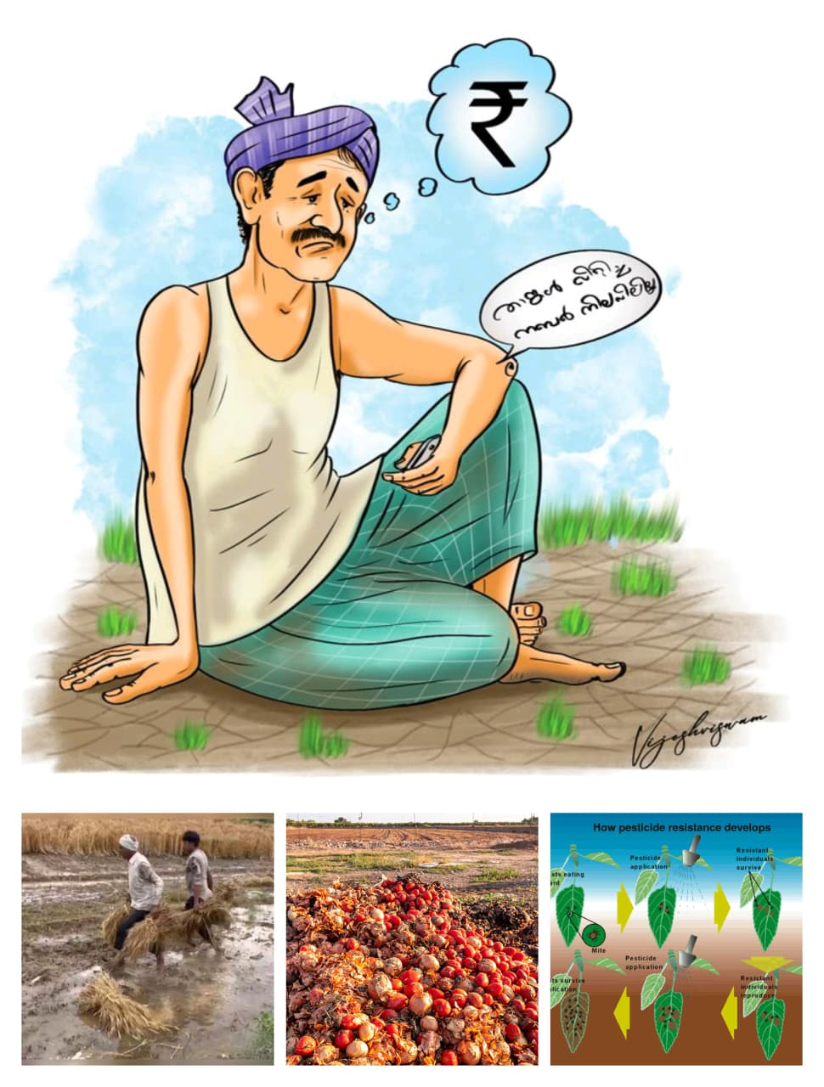
A Social Initiative by
A Social Initiative by
What problem are we trying to solve?
“Farmers often lack easy access to accurate agricultural information, guidance on government schemes, and market insights. Limited digital literacy and smartphone usage make it difficult for them to benefit from existing resources, leading to poor crop decisions, lower income, and wasted effort.”

Slide 3
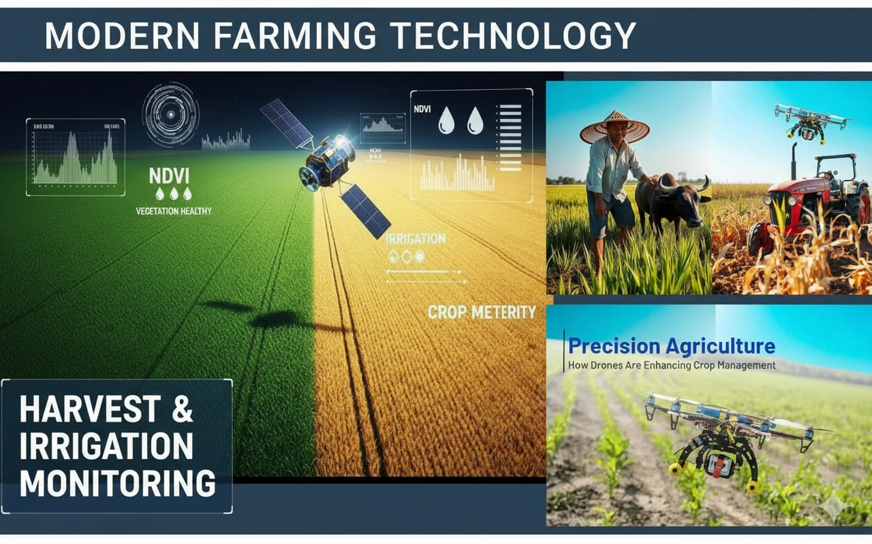
A Social Initiative by
MAHARSHI
AgriGuide (our solution):
The 360 degrees APPROACH COVERS THE COMPLETE CYCLE FROM SOIL TO MARKET.
Easy to use app for farmers with minimal technical knowledge.
Poor access to affordable vehicle and equipment rentals delays crucial farm operations.
Personalized crop,irrigation and market guidance.

Slide 4
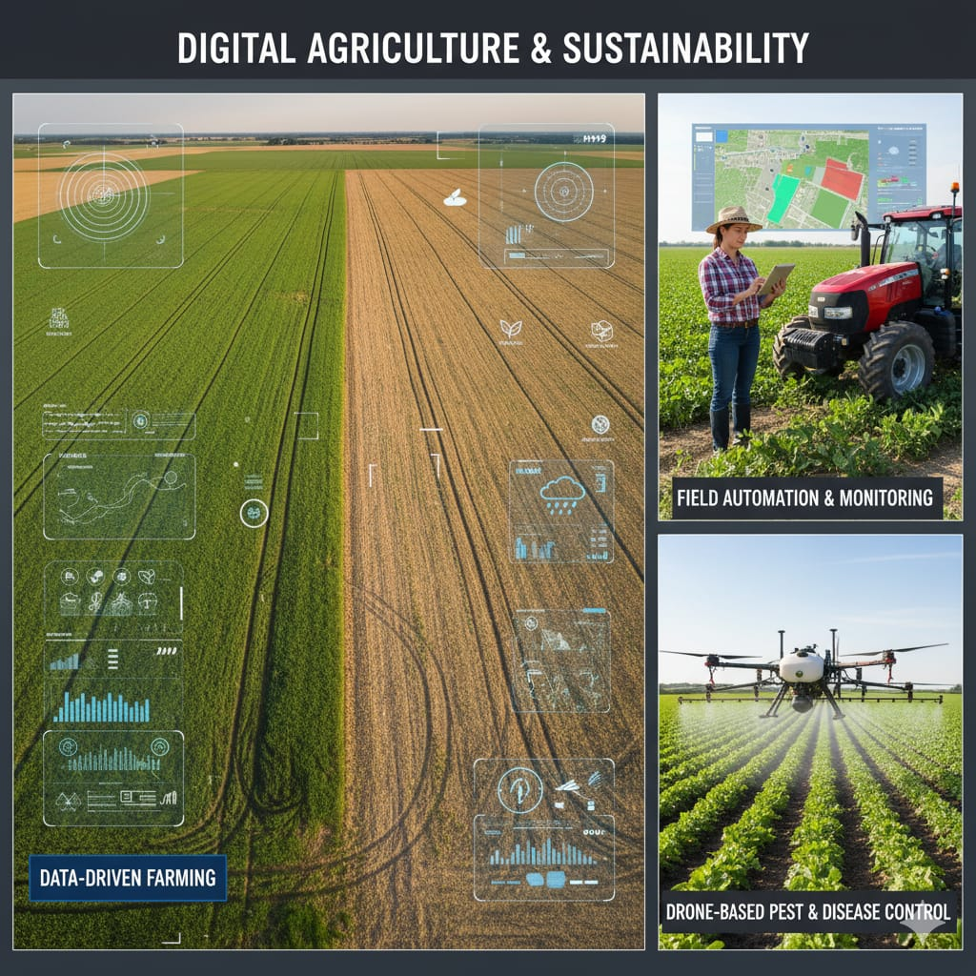
A Social Initiative by
Low digital literacy prevents many from using modern agri -tech tools effectively
Real-time alerts on weather , diseases and prices.
MAHARSHI ensures equal access for all farmers — even those without smartphones or internet, through voice calls, SMS, and local support centers.

Slide 5
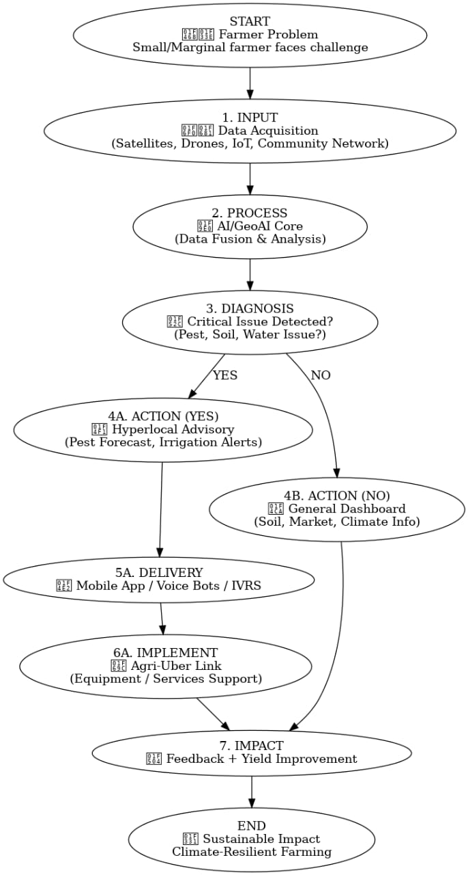
A Social Initiative by
Technologies we used :
AI/ML
IoT Sensors
NLP(Language AI)
Cloud Computing
Satellite Data(Sentinel , NavIC , BHUVAN)
Best Approach (Why?):
Integrates AI, IoT, and drones for real-time, actionable farming insights.
Promotes sustainable and climate-resilient agriculture.
Voice-based and regional language support ensures inclusivity for all farmers.
Boosts productivity, income, and food security effectively.

Slide 6
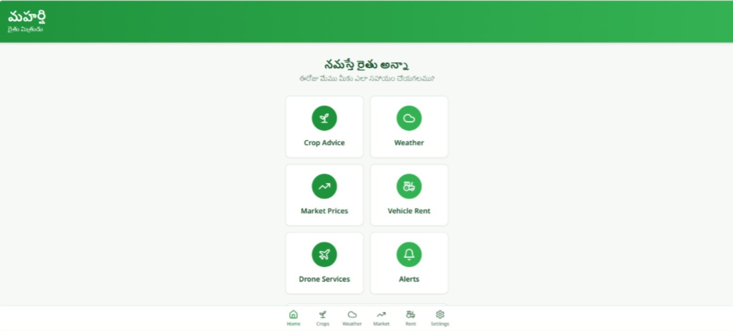
A Social Initiative by
Prototype Demo
It has six main options: Crop Advice, Weather, Market Prices, Vehicle Rent, Drone Services, and Alerts.At the bottom, there’s a navigation bar with icons for Home, Crops, Weather, Market, Rent, and Settings.
<<The 360 Degree Approach>>
Include visuals like prototypes, sketches, or CAD renders.

Slide 7
A Social Initiative by
Social Impact
Farmers – empowered decision-making, higher profits, reduced exploitation.
Rural communities – uplifted economy and better living standards.
Agricultural networks – streamlined supply chains and reduced losses.
Policy makers & NGOs – real-time insights to support meaningful interventions.
Future generations – sustainable farming practices securing food and environment.

Slide 8
A Social Initiative by
Impact & Next Steps
Impact
Next Steps / Aspiration:
Empowers farmers with real-time crop advice, weather alerts, and market insights
Voice translation enables even non-literate farmers to access information easily.
Agri-Tech Rentals make modern machines affordable and shared among farmers.
DaaS (Data-as-a-Service) helps analyze soil, climate, and yield for smart farming.Builds a digitally connected, self-reliant rural ecosystem aligned with Viksit Bharat 2047.
Develop and test the Maharshi prototype in real farming communities.
Integrate AI, voice translation, and DaaS for intelligent recommendations.Partner with agri departments, startups, and NGOs for large-scale rollout.
Expand the Agri-Tech Rental system to support small and marginal farmers.
Evolve into a social impact startup promoting sustainable, tech-driven agriculture.

